Slide 1
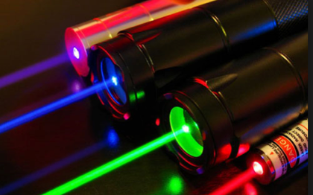
Wavemon Laser Diode Wavelength and Power Meter

Slide 2
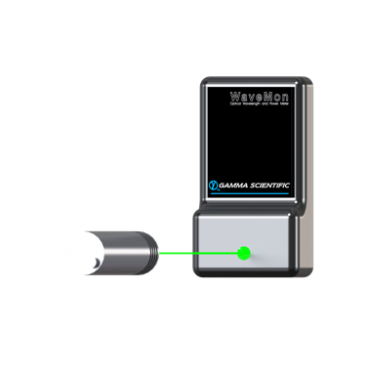
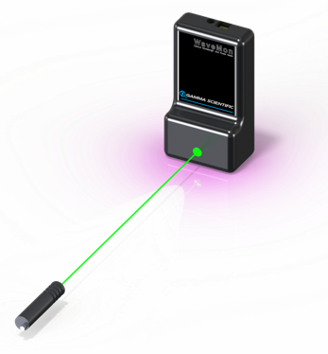
Gamma Scientific Wavemon
Compact Laser diode Wavelength and Power meter
Electronics and Sensors are integrated in a small package

Slide 3
Gamma Scientific Wavemon
Measures peak wavelength and optical power of laser diodes
380nm to 1050nm wavelength range.
0.25 nm wavelength resolution with 0.01 nm repeatability
Temperature stabilized for superior stability and low noise floor.
No need for external electronics. Data output via USB to Windows/OSX/Linux computer or Tablet using Wavemon application software.
Compatible for free space and fiber measurements
Designed for use as a research or production measurement tool.
ISO 17025 certified and NIST Traceable calibration

